Slide 1
My Presentation
Anthony Wilde

Slide 2
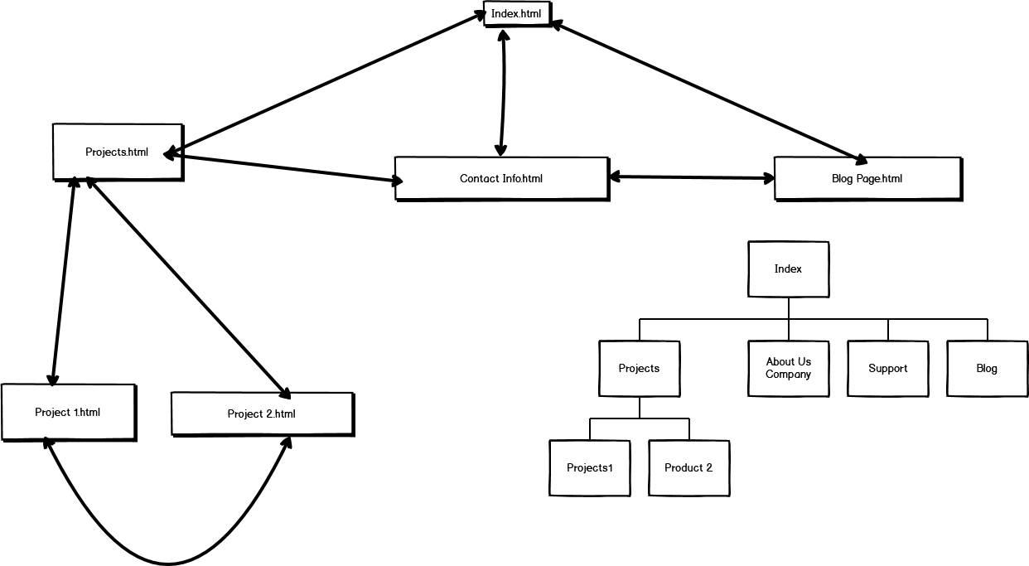
Site Map

Slide 3
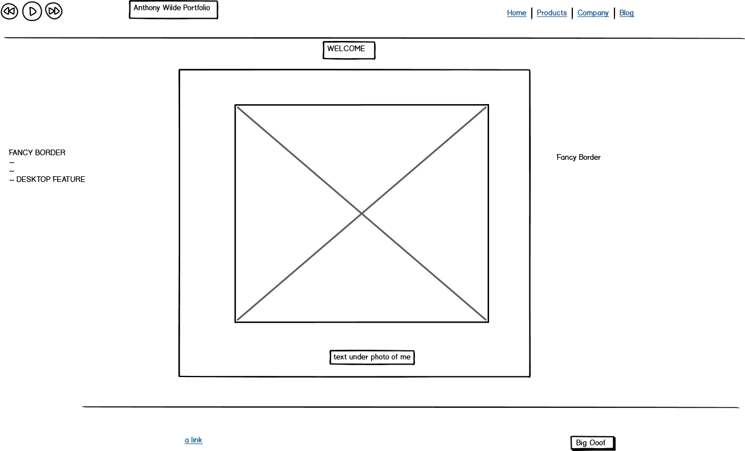
Index/ Home Page

Slide 4
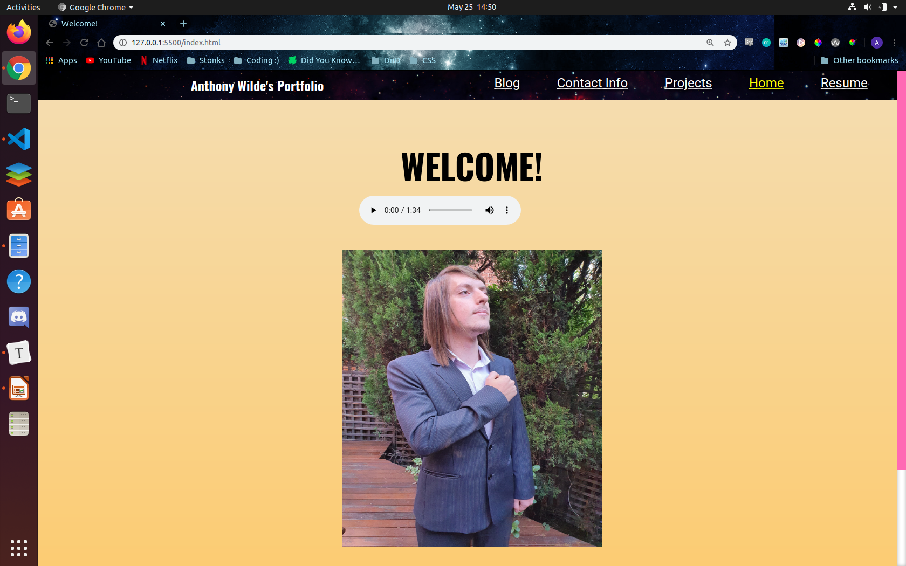

Slide 5
Index/Home 2 : Electric Boogalo
Nav bar - First thing i worked on, it was important, all pages use it. Background is space img to make it stand out on the page, the font of the nav bar is white itself to stand out on the background. It has a fixed position with a z-axis so it follows you when you scroll through a page (thankyou Brandon and Carl), meaning you can always change to a different page at any time in the experience. Was difficult to get it to work for all screen modes. Footer and Header feature similar designs but only Header follows you.
Media player - Added files to folders to make both images and songs work within the website. Had to understand file navigation. Used HTML, readjusted position with CSS.
Margin on paragraphs - After feedback from user added margins to paragraph for enhanced visibility. Made margins based on VW (view width) and applied to all examples of paragraphs throughout the web page.
Hover - I had a hover effect feature on the image in the center, had complications with mobile/ tablets so was removed.
Background - The background color was used to appear mild and not to attracting causing the user to focus more on the content of each page as oppose to the background. It has a small linear gradient so the color gets darker as you scroll. It is the same background on each page.

Slide 6
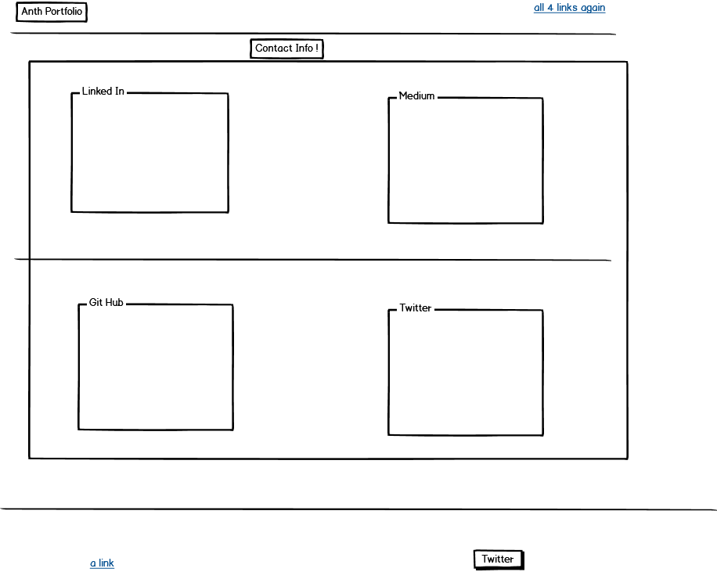
Contact

Slide 7
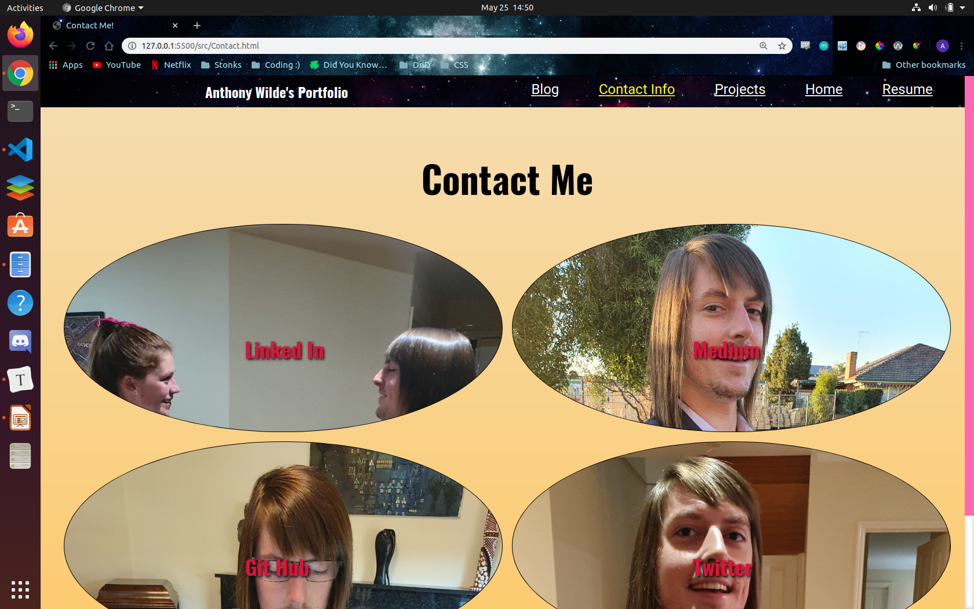

Slide 8
Contact Page
Pictures - Each contact info picture has a tag that has been cropped to appear circular/oval, the 'a' tag links you to a different website. The links themselves are colored and have shadows for full visibility with background, as well as changing color when you hover over them to a bright yellow. The page is grid based and the a tags fill out over the oval. The pictures expand and contract to fit the different sizes effectively. Unlike other pages img tags are not used here instead pictures are background pictures added to div's

Slide 9
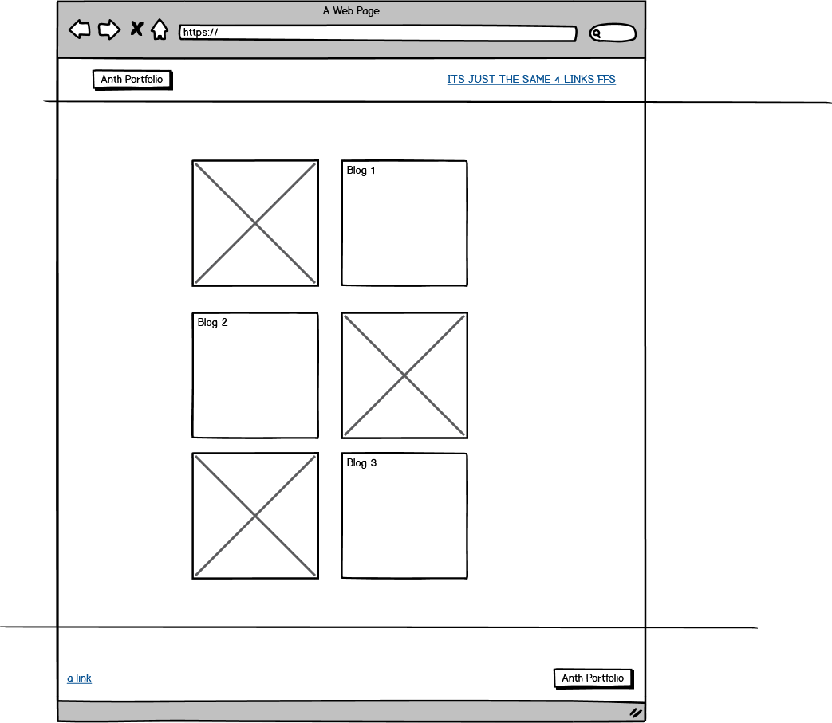
Blog

Slide 10
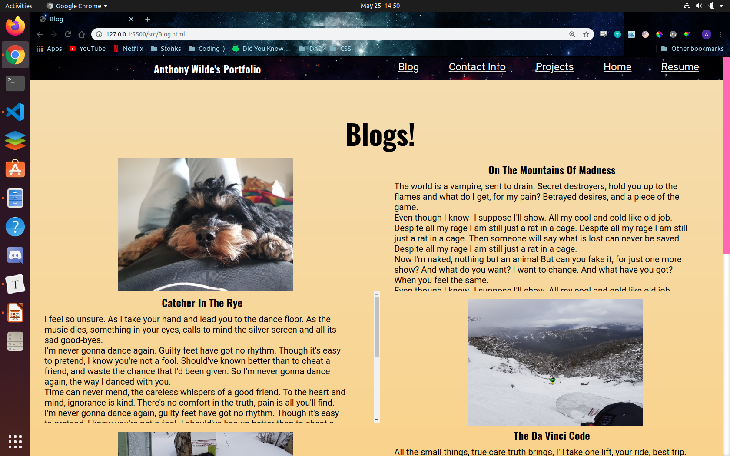

Slide 11
Blog
Flex-box vs Flex-grid - On mobile this page is a flex box flowing downwards, on tablet and up this page becomes a flex grid having a image then a blog post like the wire frame. Grid made the page easier to adjust for size.
Scrolling - On all devices a scroll feature was added so the paragraph grid cells do not overflow and content disappears behind images or footers. Scroll made sure content did not stretch the page.
Looks most like its Wireframe.

Slide 12
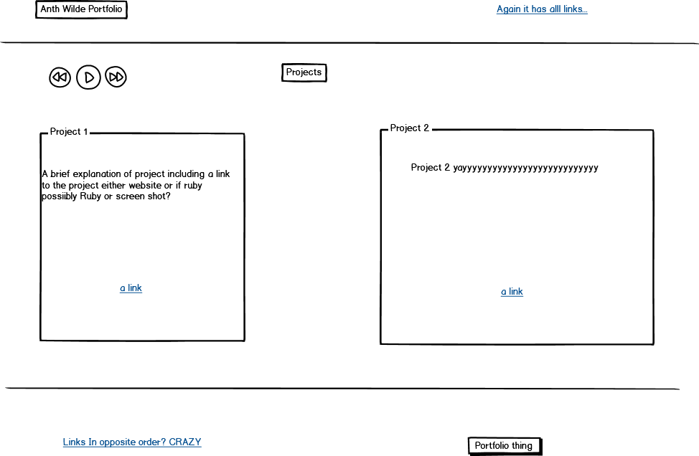
Projects

Slide 13
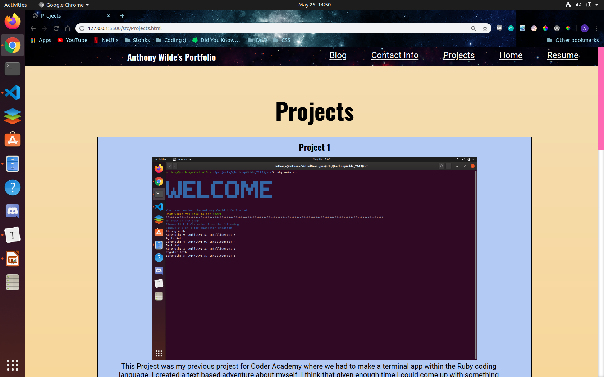

Slide 14
Projects
Framework – Immediately went off framework idea as it would not allow for good encapsulation of ideas/images of my work. Decided on Flex box concept going down the page.
Background – Have a soft baby blue color to show/separate all 3 projects shown into separate boxes. Also not being to strong a color for the content within to get smothered. Color blends with background quite nicely.
Images – Images on this page are img tags embedded within ‘a’ tags to make it so that when you click on a image you are sent to the page that the project is referring to.

Slide 15
Final
Fonts – My pages all feature a font type of Oswald for all h1,2,3 or 4 and Roboto for paragraphs. I also made all ‘a’ tags Oswald font as well. Both fonts are from Google Fonts.
Scrollbar – Only visible on my desktop mode version of the site, the scroll bar is hot pink, making it easily visible on the side of the page.
Images – All images on the site have alt variables for help with the visually impaired.
My Favourite parts of this assessment were the parts that had nothing to do with the assessment and submitting it.

